Slide 1

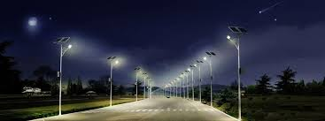
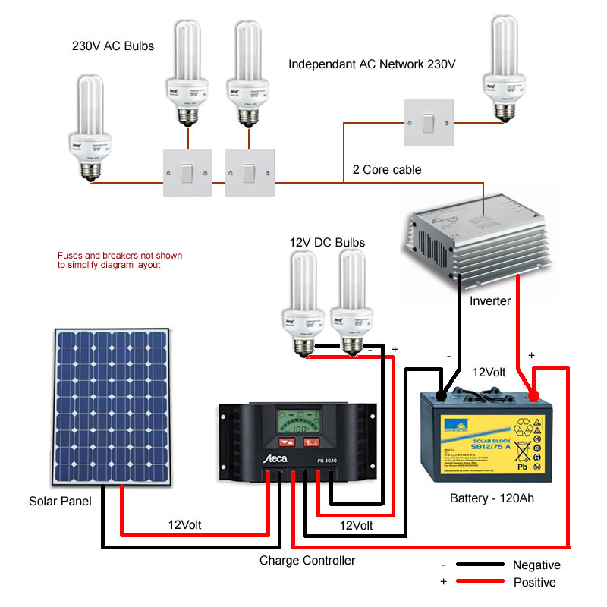
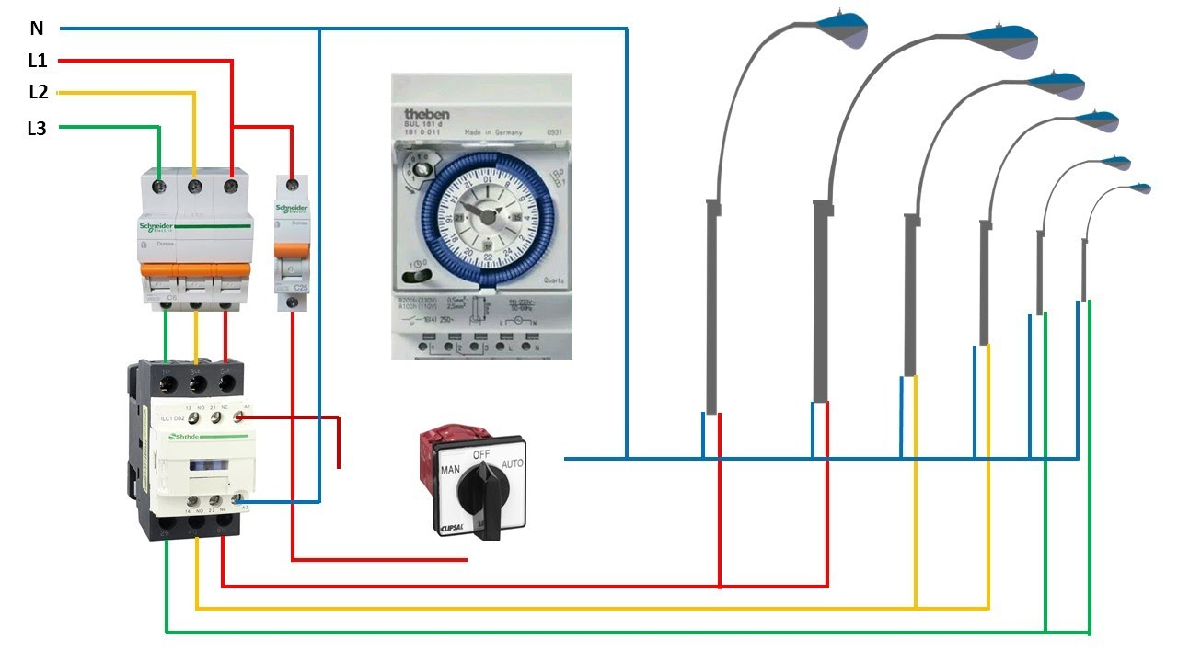

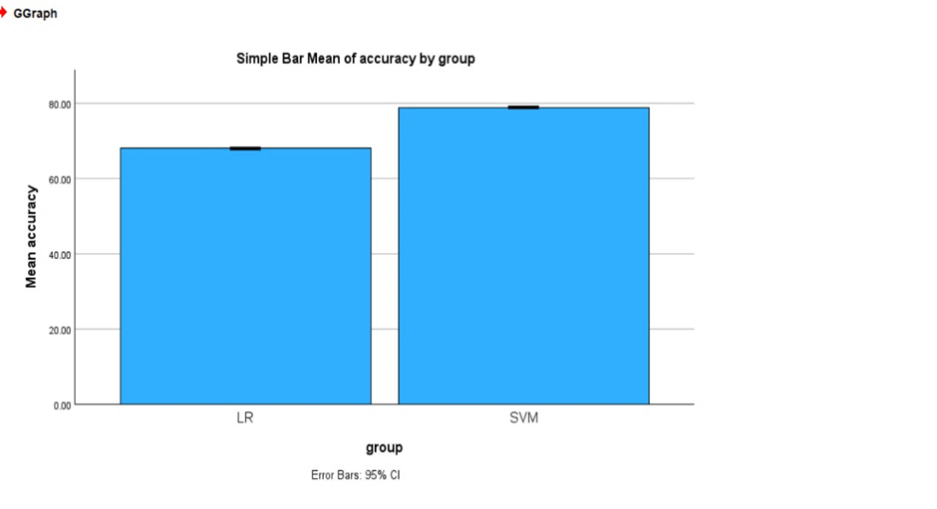
Student Name: BELLAMKONDA NAGESWAR Register Number: 192372005
Guide: Dr. S. CONSTANCE ANGELA
Ms. Poorani.S
Guided by Dr. Mary Valantina. G
“BRIGHTER CITIES: ILLUMINATING THE EFFICIENCY IN URBAN STREET LIGHTING”.
INTRODUCTION
To revolutionize urban street lighting with LED technology for increased efficiency and reduced carbon emissions.
Enhancing safety for nighttime driving, minimizing environmental pollution, and reducing Maintenance costs for governments.
Integrating smart sensors and advanced control systems for adaptive lighting solutions to improve visibility and traffic management.
Collecting data on energy usage, lighting patterns, and environmental impact to optimize street lighting efficiency.
Implementing algorithms for automated lighting control and optimization based on real-time
data analysis
MATERIALS AND METHODS
RESULTS
Accuracy | Group | N | Mean | Std.Deviation | Std.Error Mean
 | svm | 15 | .24985333 | .000106010 | .000027372
 | Lr | 15 | .44680667 | .155480254 | .040144829
Fig 1: Comparison between group and mean accuracy
Table 1: Group stastics(t- test) comparision between cnn and svm
DISCUSSION AND CONCLUSION
The Brighter Cities project stands as a testament to the transformative potential of modernizing urban street lighting infrastructure. By leveraging advanced technologies such as LED lighting and smart controls, cities can achieve significant energy savings while simultaneously enhancing safety and visibility for residents.
Through meticulous planning and strategic implementation, the project demonstrated the feasibility of optimizing street lighting configurations to meet the diverse needs of urban communities. Data-driven decision-making played a crucial role in identifying areas for improvement and tailoring solutions to maximize efficiency and effectiveness.
Stakeholder engagement emerged as a cornerstone of success, as community feedback helped refine lighting designs and address specific concerns related to visibility and safety. This collaborative approach not only fostered a sense of ownership among residents but also ensured that lighting solutions were tailored to meet local needs and preferences.
The findings of the Brighter Cities project underscore the importance of sustainable urban development, highlighting the role of efficient street lighting in creating vibrant, livable cities. Beyond the immediate benefits of energy savings and improved visibility, these investments contribute to long-term environmental sustainability and quality of life for urban dwellers.
Moreover, the scalability and replicability of successful strategies present an opportunity for cities worldwide to follow suit and embrace energy-efficient street lighting solutions. By sharing lessons learned and best practices, municipalities can accelerate progress towards achieving sustainable development goals and creating more resilient urban environments.
BIBLIOGRAPHY
1.Garcia, C. et al. (2018). "Assessment of Light Pollution Reduction Strategies: A Case Study in Urban Environments." Environmental Impact Assessment Review, 65, 102563.
2.Patel, D. et al. (2019). "Smart Control Systems for Urban Street Lighting: A Review of Technologies and Applications." Sustainable Cities and Society, 20, 102563.
3.Kim, S. et al. (2020). "Integration of Renewable Energy Sources in Urban Street Lighting: Case Studies from Three Cities." Renewable Energy, 45, 101-110.
4.Wang, L. et al. (2021). "Long-Term Performance Evaluation of LED Street Lighting: A Five-Year Case Study." Energy, 150, 101-110.
5.Nguyen, T. et al. (2022). "Impact of LED Street Lighting on Crime Rates: A Meta-Analysis." Crime Prevention and Community Safety, 8(4), 321-335.
6.Zhang, H. et al. (2023). "Economic and Environmental Benefits of LED Street Lighting: A Cost-Benefit Analysis." Resources, Conservation and Recycling, 50, 101-110.

